Slide 1
Software Engineering

Slide 2

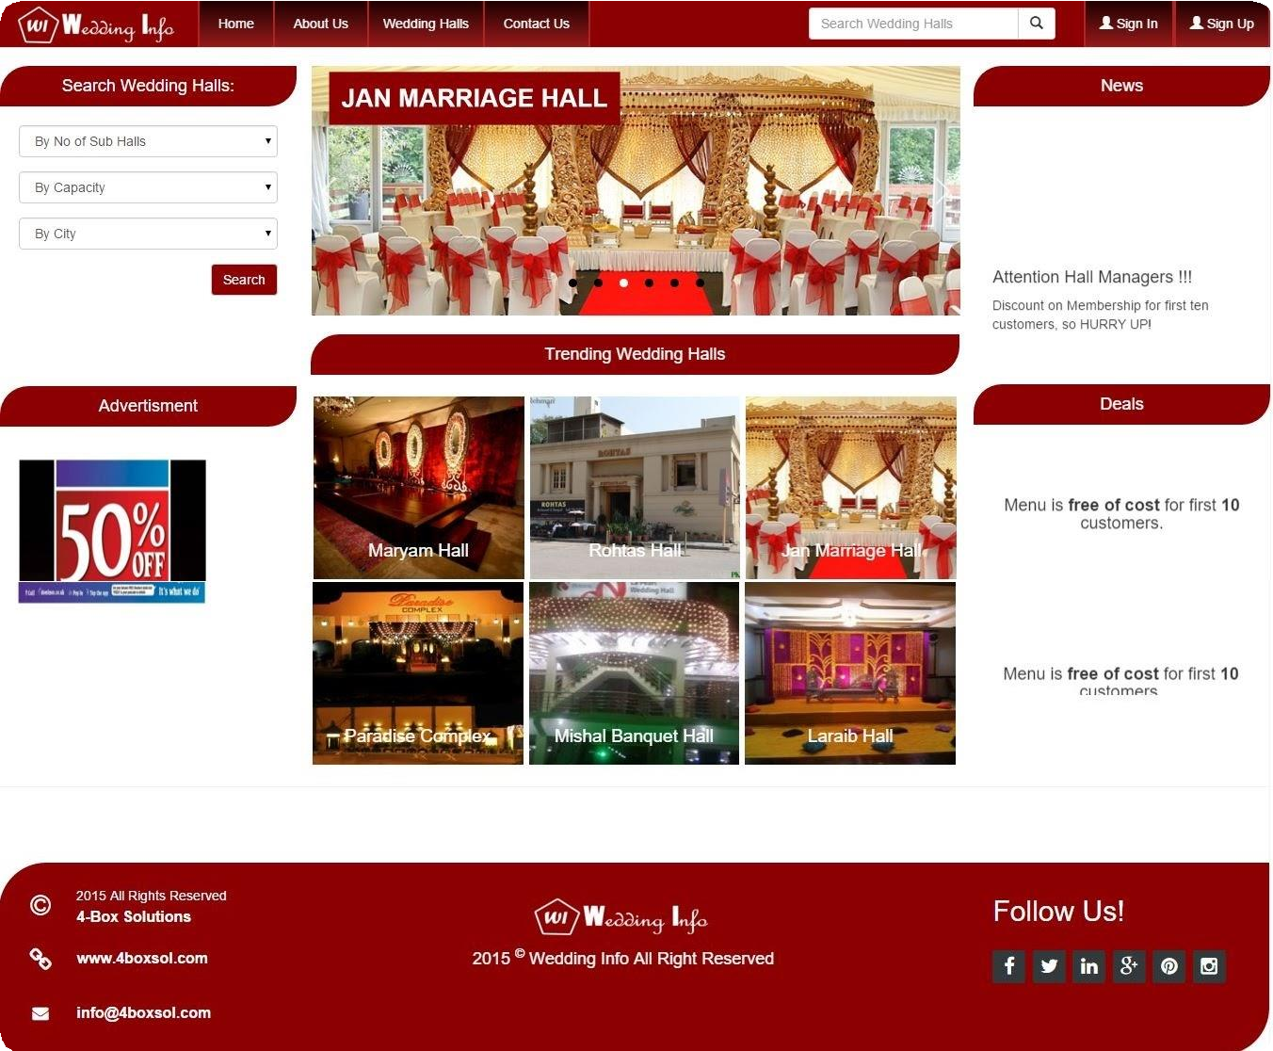

Slide 3
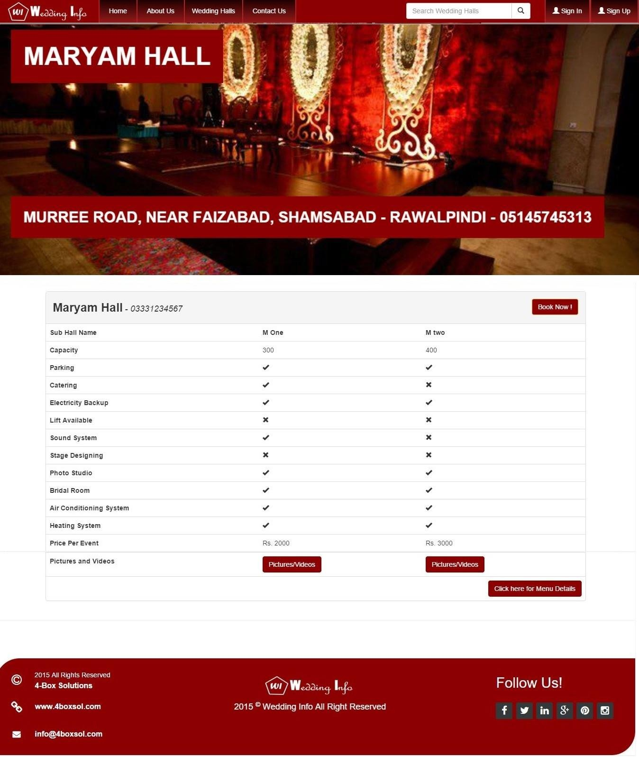

Slide 4
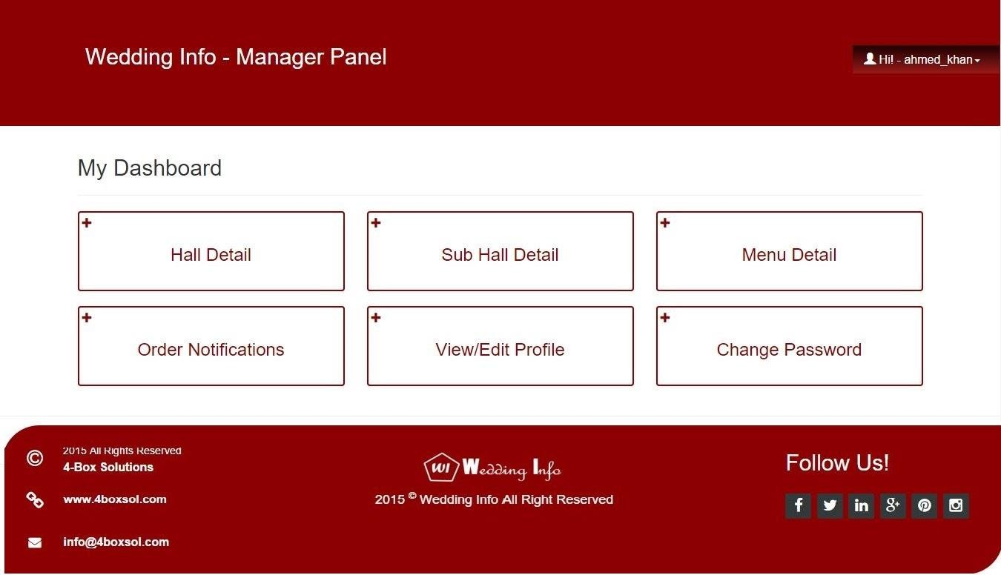

Slide 5
Tools
Figma

Slide 6
Boehm’s Spiral Model
Process is represented as a spiral rather than as a sequence of activities with backtracking.
Each loop in the spiral represents a phase in the process .
No fixed phases such as specification or design loops in the spiral are chosen depending on what is required.
Risks are explicitly assessed and resolved throughout the process.

Slide 7
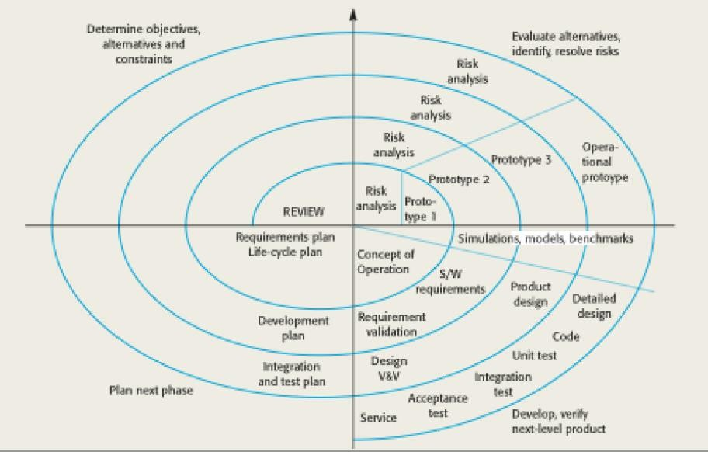
Boehm’s Spiral Model

Slide 8
Spiral Model Sectors
1. Objective setting: Specific objectives for the phase are identified.
2. Risk assessment and reduction: Risks are assessed and activities put in place to reduce the key risks.
3. Development and validation: A development model for the system is chosen which can be any of the generic models.
4. Planning: The project is reviewed and the next phase of the spiral is planned.

Slide 9
Spiral Model Usage
Spiral model has been very influential in helping people think about iteration in software processes and introducing the risk driven approach to development.
In practice, however, the model is rarely used:
Can be a costly model to use
Risk analysis requires highly specific expertise
Doesn’t work well for smaller projects.

Slide 10
When to use spiral model
The following pointers explain the typical uses of a Spiral Model −
When there is a budget constraint and risk evaluation is important.
For medium to high-risk projects.
Long-term project commitment because of potential changes to economic priorities as the requirements change with time.
Customer is not sure of their requirements which is usually the case.
Requirements are complex and need evaluation to get clarity.
New product line which should be released in phases to get enough customer feedback.
Significant changes are expected in the product during the development cycle.

Slide 11
Benefits and Drawbacks
Allows the use prototyping
Management is more
complex
Client can see the system early on
Should not be used for small projects
Changes in requirements can be made easily
This method requires a lot of documentation

Slide 12
Advantages & Disadvantages
Benefits | Drawbacks
Allows the use prototyping | Management is more complex
Client can see the system early on | Should not be used for small projects
Changes in requirements can be made easily | This method requires a lot of documentation

Slide 13
V-Model
A variant of the waterfall model
Uses unit testing to verify procedural design
Uses integration testing to verify architectural (system) design
Uses acceptance testing to validate the requirements
If problems are found during verification and validation, the left side of the V can be re-executed before testing on the right side is re-enacted

Slide 14
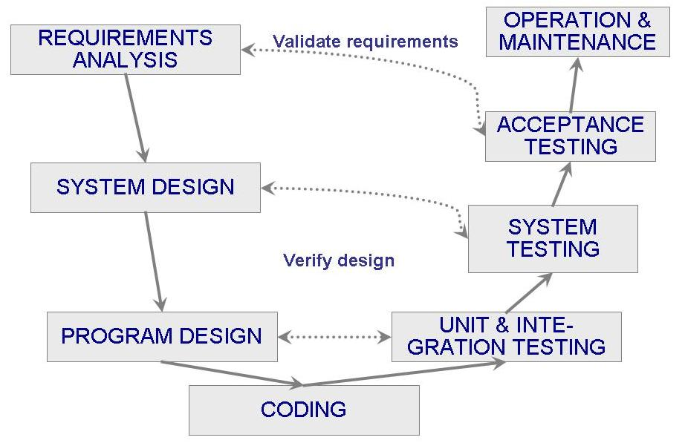
V-Model

